Slide 1




PREDICTIVE ANALYTICS
(Applications to Business Challenges)
CIFF Trustees:
Profesor: Vidal Fernández
vidal.fernandez@campusciff.net
MASTER EN BUSINESS ANALYTICS Y BIG DATA 2015 – 2016

Slide 2
Predictive Analytics as Business Solution
Predictive Analytics provides an unbeatable predictive sight for companies, that allows them to extract business value from corporate available data and external data (big data o bigger data).
It combines business understanding, advance business modeling and analytics and IT expertise to provide effective, seamless and competitive solutions
Business understanding
Advance modeling and analytics
IT capabilities

Slide 3
Analytics Process
BUILDING INTELLIGENCE
DATA
DATA VALUE
INTELLIGENCE
What data to use
How to model them
Take model results and embed them into business decisión processes

Slide 4
Analytics Methodology
SAMPLING
VARIABLES
SELECTION
SAMPLE SELECTION
DATA PARTITTION
EXPLORING
VISUAL
ANALYTICS
OUTLIERS
DETECTION
DESCRIPTIVE
ANALYTICS
NEW VARIABLES
AND METRICS
MISSING VALUES
TREATMENT
IMPROVEMENT AND FINE TUNNING
MODIFYING
MODELLING
MACHINE
LEARNING
GLM
MODELS
UNSUPERVISED
MODELS
RANDOM
FOREST
ASSESSMENT
MODEL COMPARAISONS
HYBRID MODELS
MODEL

Slide 5
Analytics Everywhere
Classify
Optimize
Analytics
Forecast
Simulate

Slide 6
Cross-Industry Predictive Analytics Solutions
Insurance
Banks
Telcos
Utilities
Industry
Non life
Life
Clients
Customer value analytics
Dynamic customer genomics analytics
Telematics analytics
Health monitoring analytics
Data traffic analytics
Smart meters analytics
Products/ Sales
Dynamic pricing
Dynamic pricing
Dynamic pricing
Dynamic pricing
Non life
Life
Churn analytics (Churn prediction / Causal churn analytics / experimentation)
Agents / Direct channels / Sales performance analytics
Recommendation engine (Cross-selling / Up-selling analytics)
Ops / CX
Predictive fraud, anomalies & fraud networks
Fraud & credit scoring
Fraud & credit scoring m.
Fraud & credit scoring
Predictive maintenance analytics
B2C&B2B
Smart grids analytics
Non life
Life
Network performance analytics
Collection & recovery
Asset maint. opt.
Dynamic customer experience analytics (CXA)

Slide 7

BIG DATA ANALYTICS CHALLENGES: Data Sources
Data Sources.
The challenge is to identify what data to use, what data sources and how to get together in an integrated form that can be used across the company.
There are tremendous amounts of data generated internally every day: customer transaction data, internal supply chain data and lots of performance data across the companies. But internal data is not all about this big challenge. Companies see real value in understanding what other external data sources (whether and climate data, traffic pattern data, competitors’ data to understand what other prices are being offered in the market, etc.) are available and bringing them in their analyses..

Slide 8
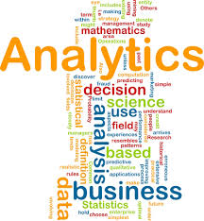
BIG DATA ANALYTICS CHALLENGES: Analytics
Analytics.
Predictive analytics requires talented people that really know statistical and mathematical methodologies to create mathematical models. Getting people with the right skills and capabilities that know the last mathematical techniques and statistical methodologies to build predictive models and get insights and find the nuggets of gold from data is a big challenge as well.

Slide 9
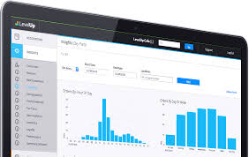
BIG DATA ANALYTICS CHALLENGES: Embed
Embed
Take those insights and use them to transform the way companies make business and operate. Nothing is going change if company doesn’t use the insights in their business processes and managers use them and operate on a data day bases. Companies have to deal with three “rights”: the right data, the right model capabilities and the right transformation methods to have your people act differently and to make decisions differently, to start the journey.

Slide 10

In-Cloud Solutions
Easy to manage
Company sends the relevant data
Step one
Step two
Step three
Cloud platform loads the data and runs the specific algorithms
Algorithms produce a Scorecard model and data transfer files for BI integration

Slide 11


Global Cloud
Easy to expand in different geographies
Cloud Platform currently operates out of many regions across the globe. (More than 90 countries), to enable customers to achieve higher performance levels and support customer requirements and preferences regarding the location of data.

Slide 12

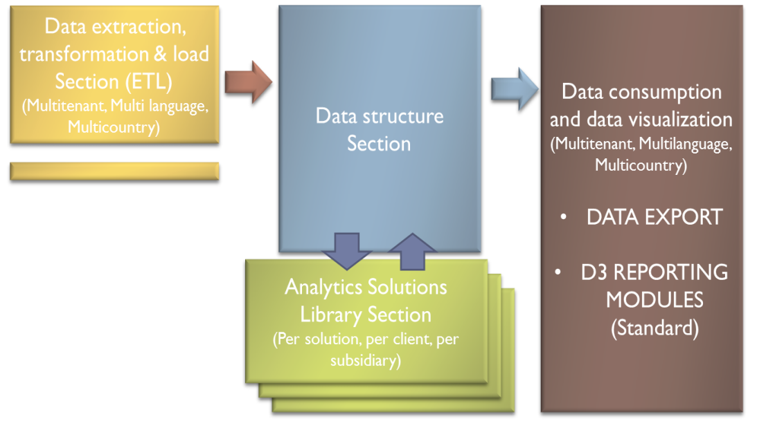
Global Cloud Benefits for Global Companies
Competitive advantages for multi-country companies
MULTI COUNTRY SCALABLILITY: A cloud based scalable platform allows us to deploy our predictive analytics solutions in different countries with significant cost savings. Synergies and economies of scales arise as number of countries included in the solution increase.
SYNERGIES: Common ETL, Data Structure & Visualization , allow cost and operation synergies cross different Countries
AD HOC PREDICTIVE MODELS: Our successful proven methodology is deployed per country, Training algorithms locally for each Country to ensure maximum efficiency using a common Data Structure.
BENCKMARKING: Multi-country comparisons and best practices visualization can be easily and quickly implemented for the countries served facilitating management and best practice cross implementation.

Slide 13
Project Scheme . Predictive Analytics
Project Methdology
Identify key variables
Segmentation & modeling
Ad-hoc algorithm validations
Analysis of results and feedback
Build set up delivery plan
Implement the solution
Working with client to discuss key business variables and data availability
Sample selection to train the analytical algorithms
Validation of analytical models and fit with the customer reality
Build the set up plan to extract, transform, and load data into the delivery platform and agree model outcomes and KPI’s interphase
Implement the solution and integrate seamless with Clients delivery business user’s needs
Measurement of model’s effectiveness and feedback to continuous updating and recalibration

Slide 14
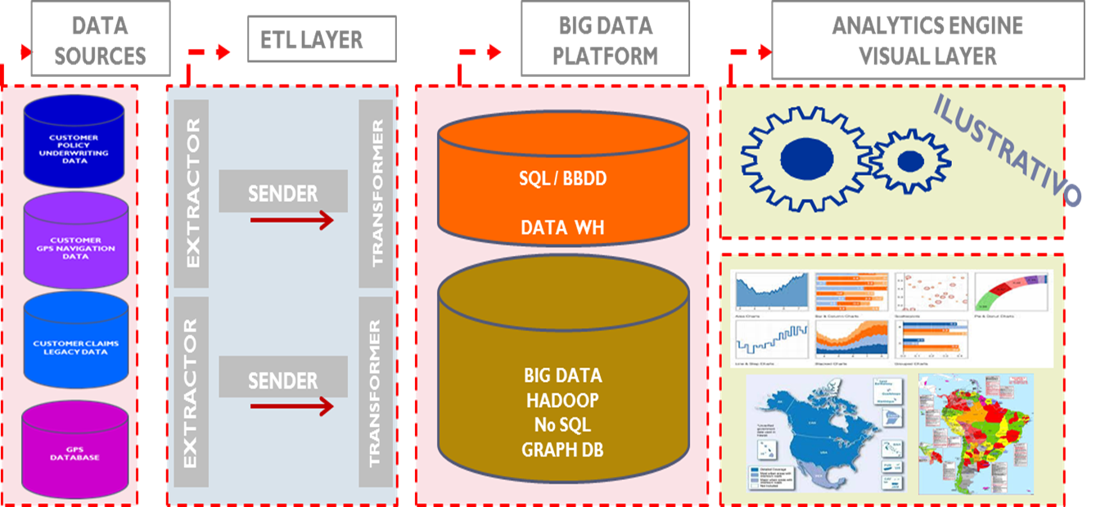
Implementation Process

Slide 15
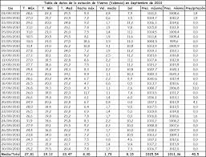
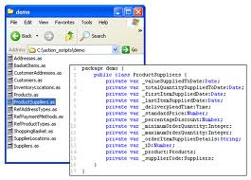
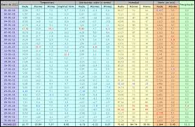
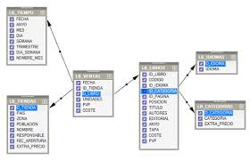
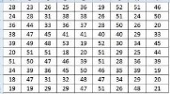
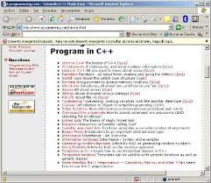
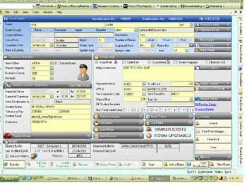
Implementation Process
PROCESO DE MODELIZACIÓN
Tabla de Datos de Modelización
Código R
Datos Ciego. Test del Modelo
Conjunto Datos de Entrenamiento (70%)
Conjunto Datos de Validación (30%)
Librería de Conversión
PROCESO DE IMPLEMENTACIÓN
Aplicación de Usuario Final
Tabla de Alimentación del Modelo
Código C, Java, NET

Slide 16


CIFF Trustees:
CLAIMS INSURANCE FRAUD

Slide 17
Fraud in figures
Fraud is one of the most important issues impacting Insurance Companies, not only from the P&L perspective but also affecting customer dissatisfaction and affecting premium pricing.
Fraud has a big impact in the P&L, and most of it is still estimated undetected.
UK estimates that total fraud accounts for 3,3 B € in 2011, 2/3 of which is undetected. In Germany fraud is estimated 4 B€ per year (1); US estimates an impact of 80 B$ per year (2).
P&L impact varies country to country and by line of business, but as rule of thumb can impact 6%-10% of gross written premiums.
False positive fraud affects honest customer dissatisfaction, impacting also the Company image.
Fraud contributes to higher premiums to honest customers, as companies generally pass its costs onto policyholders.
In the UK, ABI estimated that fraud adds, on average at least 58€ a year to the annual insurance bill for every policyholder (1).
Detection processes are improving but maintain several critical challenges.
Limited use of data available / relevant data in operations drive to use of business rules with limited learning procedures, and very high level of false positives.
Fraud causes vary significantly per line of business and geography affecting the scale to access new analytics techniques.
Lack of resources to pursue fraud limits the improvements year to year.
Insurance information exchanges and cross border cooperation is improving but still very limited in terms of P&L impact.

Slide 18
Claims Insurance Fraud: The Frame
An insurance company receives thousands of claims daily; the fraud analysis team can not detect and investigate all claims with signs of fraud. It required accurate identification and prioritization tools.
The Fraud Analysis Team can not investigate all suspect claims.
Fraud Analysis Team
Probable additional fraudulent claims .
Claim identified as fraud.
Thousands of daily claims.
Fraud Signs: claim to analyse
Claim identified as NON fraud.
Company may be paying claims which are fraudulent.
Claims w/o analysis
Payment as per coverage.
This process could be optimized.
A predictive model can estimate the probability of a fraudulent claim, so the Management Team can prioritize investigation & increase fraud detection.

Slide 19



What can Predictive Analytics do for fraud detection?
Improve fraud management efficiency through:
Better detecting fraudulent claims before they are paid.
Better classifying fraudulent claims to improve claims management.
Reducing false positive claims dramatically.
Deploying specialized algorithms by type of claim.
Deploying different algorithms as information improves.
Identifying & monitoring fraud networks as they grow.
Updating and refreshing continuously the algorithm to maintain fraud detection performance over time.

Slide 20
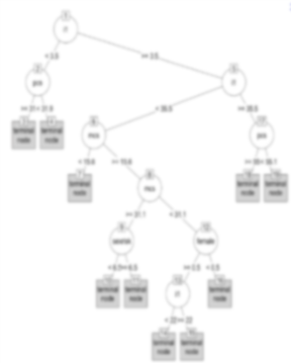
Fraud Detection based on Predictive Analytics
How can Predictive Analytics do it? Using the right combination of data and analytical tools …
OUR COMPETITOR
Red flag rules engines
Predictive algorithms methodology
Fraud networks modelling
By using the red flag rules engine can ensure seamless maintenance of current client´s knowledge and implement easily new ones by setting the tool according to the business units needs. These patterns define the base red flag rules which classify new claims as fraudulent.
By using predictive analytics models (LOGIT & PROBIT models, Machine learning, Decision trees, Support vectors Machine & evidence impact algorithm) we can find the patterns governing fraudulent claims. These patterns define the INTELLIGENCE rules which classify claims as fraudulent, done by comparing how closely the new claim follows the established fraudulent pattern previously discovered. Fraud teams can concentrate on the cases more likely to be fraudulent or with more impact.
By using LINK ANALYSIS tools, HITS pre-processing algorithms; association rules and pattern discovery algorithms, antifraud team can detect relationships, coincidences and similarities. The methodologies and tools provide the capability to detect those claims where a significant connections exists between individuals. Fraud teams can enrich on the cases more likely to be fraudulent.

Slide 21
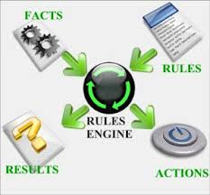

Fraud Detection based on PA: The Competitor
The Predictive Analytics Competitor…
The red flag rules engine allow claims agents to define indicators that define claims as potentially fraudulent.
Claims agents can easily choose fields in the datamart and can create logical links to define existing or new red flag rules based on experience .
Once the rules are created, a set of validation parameters, such as statistical testing, descriptive measures and KPI’s can be analyzed to explore and evaluate the rule effectiveness.
When the red flag rules have been assessed, the claims agent can decide to implement them in the operational procedures or maintain them for future deployment.
Fraud identified and false positives rates can be visualized for every rule defined.

Slide 22
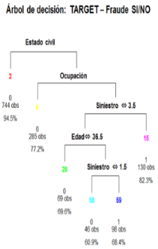
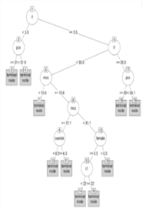
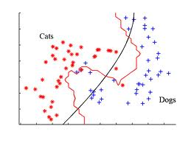
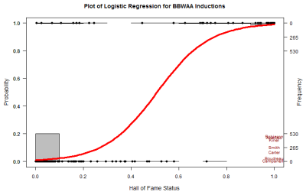
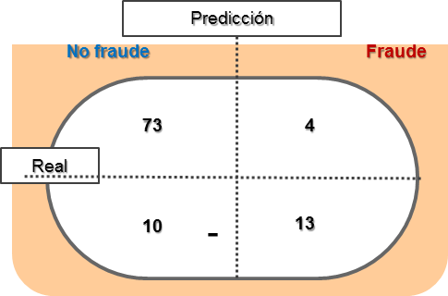
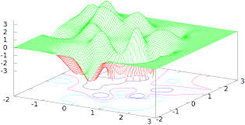
Fraud Detection based on PA: LOGIT – Machine Learning
Our key weapons to fight against Red Flag Rules Engine: The right combination of data and analytical tools …
WoE algorithm
Random forest - LOGIT
Machine learning - SVM
A set of mathematical algorithms used to select the factors and the thresholds that impact on the event to predict.
Mathematical algorithm able to predict if an event is going to occur. A set of rules is created based on those factors related to the event.
Used to predict the probability of an event occurrence conditioned by the presence of other factors, using both artificial intelligence learning, structured models or hybrid models.
Information Value

Slide 23
Fraud Detection based on PA: Fraud Networks
And also ...
Functionality I
Functionality II
Link analysis
HITS pre-processing algorithm
Association rules & pattern discovery
By using LINK ANALYSIS tools, claims team can detect relationships, coincidences and similarities. The methodologies and tools provide claims teams with the capability to detect those claims where a significant connection exists among entities: people, cars, providers, e-mail, bank account, …. Claim teams can enrich on the cases more likely to be fraudulent.
HITS pre-processing algorithm is used when an agent user wants to investigate existing relationships for a particular entity in a claim. HITS algorithm provides the most relevant claims to business users’ queries. This adjacency matrix is the input of association rules & pattern discovery algorithms .
By using association rules and pattern discovery algorithms, a business user can investigate the existing relationships of a particular entity in a claim. These algorithms provide claims teams the relevant and significant relationships for the particular entity of a claim chosen by business users and the relevant claim set provided by HITS pre-processing algorithm.

Slide 24
CIFF Trustees:
CUSTOMER EXPERIENCE

Slide 25

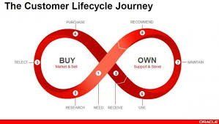
Framing Customer Experience
Customer Experience is one of the biggest challenges for industries.
Companies with higher satisfied customers scores lower defection rates and higher promoters rate.
Near to 12%* of CUSTOMER BASE abandonment come from dissatisfied customers.
Almost 83% of customers that declare dissatisfied on how their companies handle their claims and relationship, are thinking to change or already changed their company provider*.
A negative Customer Experience in just one of the touch points can impact dramatically on customer relationships and, consequently, it may trigger customer churn.
The challenge is to manage heterogeneous data sources, both structured and unstructured data, to re make better decisions and more proactive ones.

Slide 26



Customer Experience based on Predictive Analytics
What to do?
We need tools to improve customer experience monitoring in overall of the touch points of the customer journey .
Provide a holistic view of the experience at individual customer level by building a specific customer satisfaction indicator.
Better understanding of the gaps between customer expectations and service quality in key touch points of the customer journey.
Specialized algorithms to analyze heterogeneous and very complex data: text, voice, data, …
Facilitate the customer experience impact evaluation in every management initiative / loyalty program when targeting key variables.
Increase customer satisfaction and reduce product cancellation.

Slide 27
Customer Experience based on Predictive Analytics
What to do?
Define and implement TWO ANALYTICAL MODULES that allow:
Module I. Identify key variables that impact on customer experience AT CUSTOMER LEVEL and its evolution, allowing any aggregation analysis by segments, channels, departments or single customer.
Module II. Evaluate any management initiative (including loyalty programs) impact on CUSTOMER EXPERIENCE INDEX. It allows managers to better targeting & understanding churn causes and better execution of effective retention campaigns, among others.
Predictive dynamic customer experience MODEL
EVALUATION MODEL of management Initiatives in customer experience

Slide 28
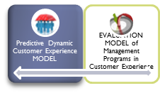
Customer Experience based PA
What to do?
D3 Predictive dynamic customer experience MODEL allows insurers to leverage all available data along customer journey to identify key variables that impact customer experience, at individual customer level. It also allows to monitor and track the evolution.
Main Product / Value
Complementary services / Value
Claims Mngt.
Claims Resolution
Admin
Sales / Agents
General support services
Other external data
Client communications
Sales reports
Claims docs
Historical data
Underwriting policies
CC records
Service usage levels
Product details
Client segmentation variables
NPS surveys
Complains
CC Indexes
Products & services satisf. INDEX
Value satisfaction (price & reputation) INDEX
Sales sats. IND.
Claims touch points management satisfaction INDEX
Admin. sats. INDEX
CUSTOMER SATISFACTION INDEX at individual customer level

Slide 29
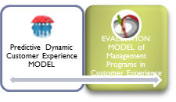



Customer Experience based PA
What to do?
D3 Predictive evaluation MODEL allows insurers to QUANTIFY the impact on the EXPECTED CUSTOMER SATISFACTION INDEX of any management Initiative and loyalty program. It allows to compute ROI (economic impact), and facilitate to incorporate customer experience target indicators in management culture.
ILLUSTRATIVE
EXPECTED target customer exp. index
Management action program (Including loyalty programs)
TARGET CUSTOMER:
KEY ACTIONS:
KEY performance indicators and targets
Timing
Expected investment
D3 EVALUATION MODEL
Current customer exp. index

Slide 30
Customer Experience based Predictive Analytics
How to do it?
Integrating complex and heterogeneous data from different data sources in a Big Data platform .
Deploying complex mathematical algorithms to identify the gaps and build a satisfaction index at individual customer level.
Training algorithms continually to improve performance overtime …
… and implementing them: reporting when a significant change on customer satisfaction index happen, at required level (by customer, business process or segments).
Integrating complex and heterogeneous data in a BIG DATA managed platform
Mathematical algorithms to identify gaps
Training algorithms continually
Evaluation model

Slide 31

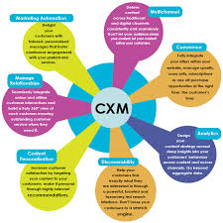
Customer Experience based PA
How to do it? First , working together, with the customer, we identify critical factors and touch points with customers to map processes, tasks and data availability:
Products & services
Product usage
Buying moments touch points
Customer Care
Services moments touch points
Other

Slide 32
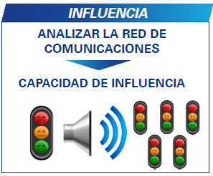
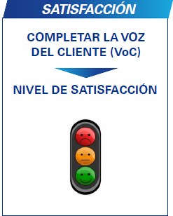
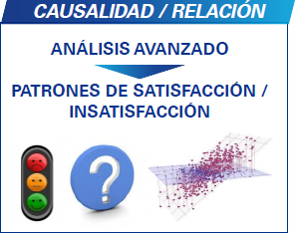
Customer Experience based PA
How to do it?
Then, relevant data is captured all the from the overall data sources across the customer journey.
UNSTRUCTURED
EXTERNAL DATA ENRICHMENT &
VOICE FILES
CUSTOMER SURVEYS
VOICE FILES
SOCIAL NETWORKS
CUSTOMER QUALITY SERVICE
CUSTOMER BEHAVIOR
PRODUCT
OPERATIONAL DATA
DIRECT
SURVEYS ANALYSIS
KPI´s on the Customer Journey Touch Points
CX INDEX
CUSTOMER FILES
COMPLAIN FORMS
OTHER
INDIRECT
CUSTOMER INTERACTION OPERATIONAL DATA
STRUCTURED

Slide 33
Customer Experience based PA
How to do it?
Data captured is integrated in a BIG DATA Managed Platform (BDMP).
ETL Security Layer
Extractor
Data Export
Data Source
Access Security
Sender
SQL BD /
Data WH
Data Export
Extractor
Transformer
Injector
Extractor
Big Data
Hadoop
No SQL
Graph DB
Data Usage
Data Source
Access Security
Extractor
Sender
Transformer
Data Security
Injector
Data Mart
or
Data Access
Core Analytics
R / Others
Middleware
Mid-Tier
Core Security Layer
Extensibility
API
Front-End
Custom Analytics
R / Others
Access Security
Reporting
or
Predictive

Slide 34
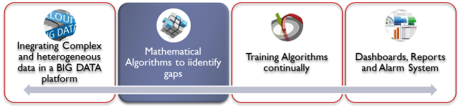
Customer Experience based PA
Predictive dynamic customer experience model
Multifactor analysis
Structural & simultaneous equations
model
Cluster & SOM analysis
How do we do it? We deploy a set of algorithms to analyze complex and heterogeneous data.
By using multivariate factor analysis, we identify latent relevant variables impacting customer experience and build customer experience indexes for every business processes at individual customer level. It allows companies to track customer experience across business processes and identify the what variables are involved.
Structural & simultaneous equations, allows us to identify what drive customer satisfaction and dissatisfaction. We can also weight the drivers’ impact on customer satisfaction and how the interactions between different business processes may affect to customer experience.
Cluster & SOM analysis, allow us to deploy a segmentation analysis based on different criteria to implement a set of strategies and actions to improve customer experience.

Slide 35
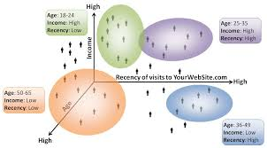
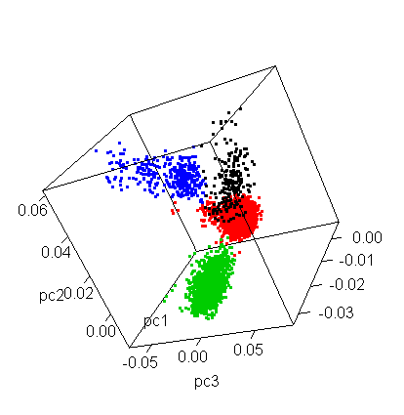
Customer Experience based PA
How to do it?. Multifactor analysis
Multifactor analysis allows us to build precise CUSTOMER SATISFACTION INDEXES, at individual customer level, based on a huge and very detailed variables extracted from a set of different and heterogeneous data sources .
CUSTOMER SATISFACTION INDEXES can help marketers to track and monitor customer experience across business processes, at individual customer level or any other aggregations according to business needs.
CUSTOMER SATISFACTION INDEXES can be disaggregated in the set of variables from which they were built to have a better understanding of what drive customer satisfaction or dissatisfaction and the drivers’ weights .
Multifactor analysis allows marketers to have a better knowledge about customer experience drivers across the overall customer journey thanks to, both a graphical visualization and an actionable scorecard business processes oriented, at individual customer level or any other aggregations business experts may require.

Slide 36
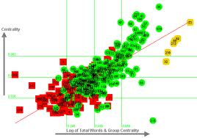
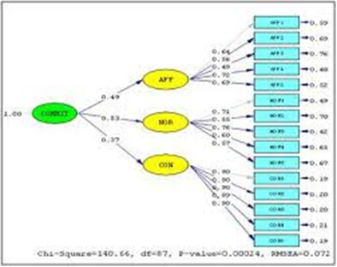
Customer Experience based PA
How to do it?. Structural and simultaneous equations model
This way we can:
Build a customer satisfaction curve to monitor and track customer satisfaction evolution for every business area. We can estimate signification bands and shoot an alarm when low limit is overtaken.
Identify business areas weights on the global customer experience index of the insurance company, allowing to have an integrated overview of business processes and business areas and the influence on customer experience.
Model also gives marketers and business experts the opportunity to evaluate the impact on customer experience of every management initiative or loyalty program they plan to execute and implement.
Marketers now have an unbeatable tool to better understand of customer experience along the overall customer journey.

Slide 37
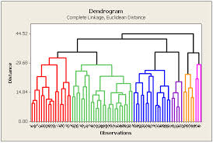
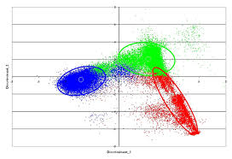
Customer Experience based PA
How do we do it?. Cluster and SOM analysis
Cluster & SOM analysis allows us to deploy an advanced segmentation and cross-segmentation of customer database, regarding different criteria.
Customer experience score.
Business processes and business units.
Customer metrics: behavioral segmentation, customer value segmentation , …
Others.
Cluster & SOM analysis allows us to build a customer experience map to have a complete overview of the experience of your customers, segmented for different criteria above mentioned.
Marketers can deploy different strategies and tactics to improve customer experience regarding different segments.

Slide 38
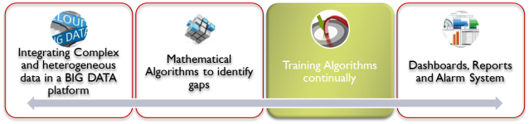


Customer Experience based PA
How to do it?. … and continually training algorithms to improve performance overtime
Algorithms need to be updated continually to ensure the precision and accuracy of customer experience.
The methodology focuses on three stages:
Monitoring.
Algorithms are continuously monitored to ensure robustness, precision and accuracy.
Re-calibration.
In addition, re-calibration is done as new data is added, and as retention program feedback is included.
Training
Algorithms are periodically trained to ensure their effectiveness and stability over time.

Slide 39


Customer Experience based PA
How to do it?. Evaluation model
Evaluation model allows business managers to quantify the impact on customer satisfaction index of every management initiative or loyalty program before it is implemented or executed.
Impact quantification can be computed at customer level or any other aggregation criteria:
Business processes and business units;
Channel;
Any segmentation criteria;
Others.
Business managers can identify target variables with greatest impact on CX at any aggregation level.
EXPECTED target customer exp. index
Current customer exp. index

Slide 40
Customer Experience based on PA
What to get it?
A set of indicators that you can configure, to track and monitor your key customer satisfaction at individual level, and anticipate trends to correct in satisfaction.
A customer oriented tool, to identify what drives customer experience and its relative importance of the different drivers.
A process oriented tool, to identify what drives customer experience at process level, and measure KPI relative importance per client segment.
A experimentation tool to measure impact in CX of a Management Action into a target Customer segment.
Alarm
report
Customer segment CX scorecard
Key KPI´s of CX, and trends
Simulation tool
Results will be delivered in a file transfer format (for client´s BI integration) and in a web based reporting tool for quick action implementation

Slide 41
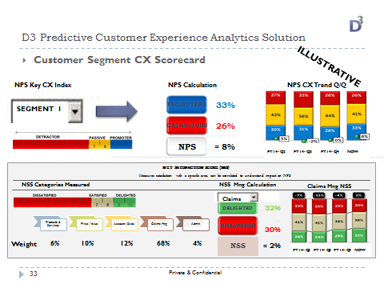
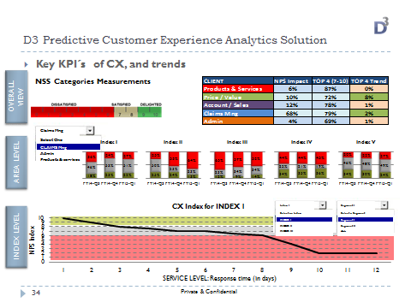
Customer Experience based on PA
What to get it?
Customer segment CX scorecard
Key KPI´s of CX, and trends

Slide 42


Customer Experience based on PA
How to work? Pilot (first).
Frame work.
The pilot will be developed for a set of customer data. (Precise definition)
Dataset.
The set of data will be made up of a significant and representative number of customers, specifically extracted from the customers’ database. We also need the last Net Promoter Score launched or similar indicators.
In addition, dataset must represent all the processes of the customer journey in order to have a complete overview of customer experience.
Algorithms & methodology.
D3 will deploy its methodology and algorithms adapted by customer & based on customers’ dataset to have customer experience score at individual customer level.

Slide 43
CIFF Trustees:
TELECOM
FORECAST

Slide 44
dynamics of the data
Data from the telecommunications infrastructure measures has a strong seasonal component. It means that data of service request of a Telco has remarkable differences along the day, of the week, and even within the day.
Number of request provided
Day of the week
Hour within the day
Additionally to this seasonal behavior, we should note that the shape is different depending on the area where the infrastructure is being inspected. The shape changes in response to the internal infrastructure use and to the utilization of neighboring or surrounding geographical locations.
The daily movement of people from their home to the office, changes the number of request to the BTS along the path from home to the office and vice versa.
Business area
Residential area
BTS
Business area
BTS
BTS: Base Transceiver Stations
BTS
Day of the week
Residential area

Slide 45
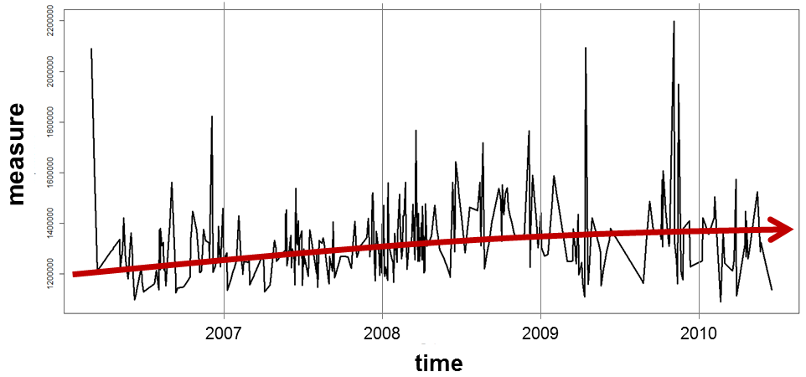
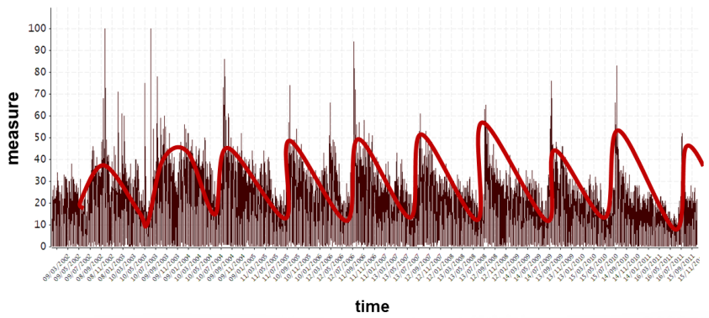
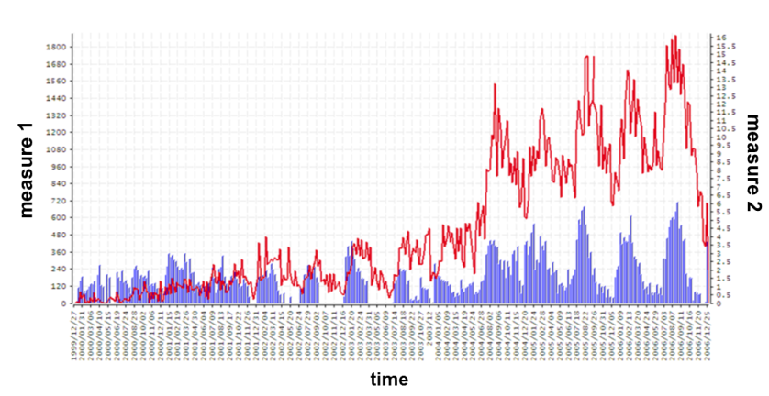
data modeling: outlook
To estimate how this set of temporal and geographical factors impact to the target variable, we use Time Series Modeling, since this type of mathematical model reflects very well the following main concepts:
Trend
Time series modeling reflects these three components
Trend
Seasonality
Irregular
In general we could write the model of a Time Series as:
Seasonality
Variable target
White noise or “normal” error
Reflect the irregular component, it is equivalent to a regression model.
Reflect the trend and seasonal component.
Irregular factors

Slide 46
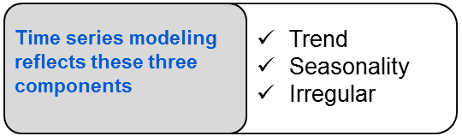
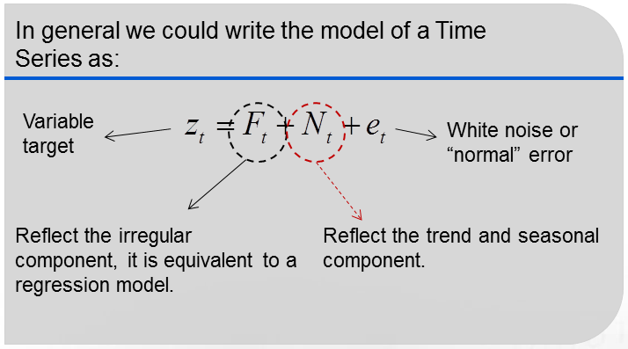
data modeling & Telco. data
As an first step in the field of infrastructure telecommunications data modeling, using this time series approach we can predict the demand services of an Base Transceiver Station (BTS).
We could write the number of incoming calls along the time in a BTS as function of, the trend observed in the data set, the seasonal average of calls demanding services and some expected factor, that usually affect to the system. This last factor could be, for instance the saturation of a neighbor BTS, since some demand services will be address to this target BTS.
f (
,
Average of incoming calls demanding services in this interval of time
)
Number of incoming calls demanding services in a specific interval of time
Trend observed historically
,
Expected irregular factors

Slide 47
Telco. Infrastructure: general hierarchy
The data of a Telco. Infrastructure will be provided through two main levels:
Network availability
Call Drop Rate
Call Set-up Success Rate
General outlook of the network performance
High level’s KPI
Operative’s KPI
Traffic usage (occupancy of a network)
Rejections
Infrastructure response
The infrastructure: BTS & BSC
The base station controller (BSC) provides the intelligence behind each BTS. A BSC could have tens or even hundreds of Base Transceiver Stations (BTS) under its management.
BSC
BTS
Diagram: BSC & BTS
Instructions in order to allocate radio resources
Raw data provided by the BTS service

Slide 48
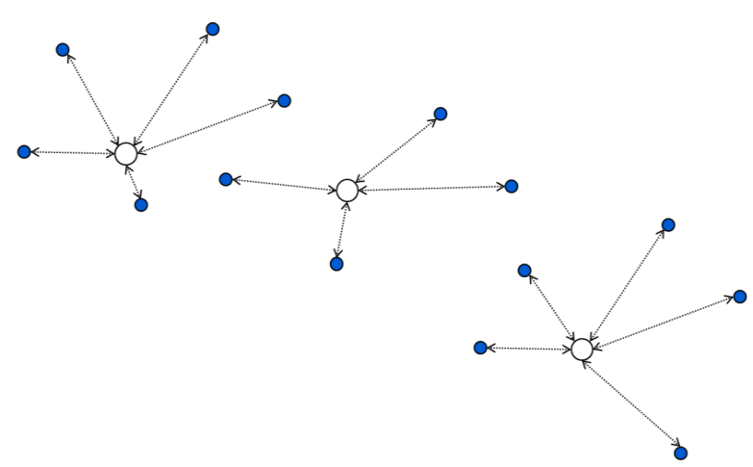
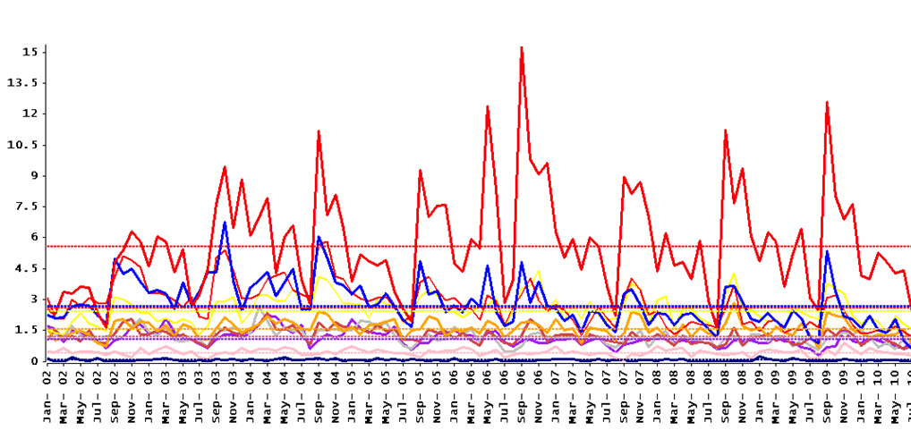
Telco. Infrastructure: general hierarchy
A regional telecommunication network is a set of BSCs with its correspondent BTS.
Regional telecommunication network
High level’s KPI
BTS
BTS
General outlook of the network performance
BTS
BTS
BTS
BTS
Performance measures from the aggregated data of the Regional Telco Network.
BTS
BTS
BTS
Time Series per BTS in the network
Infrastructure response
Operative’s KPI
Traffic use per each BTS

Slide 49
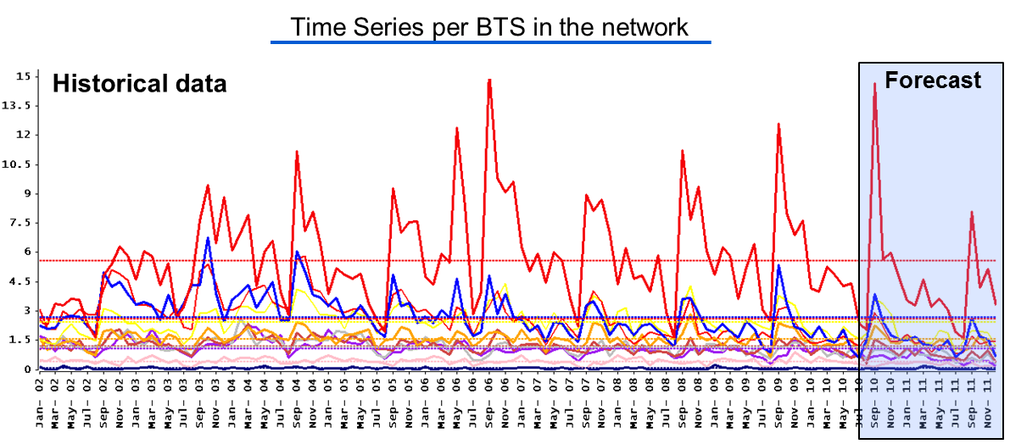
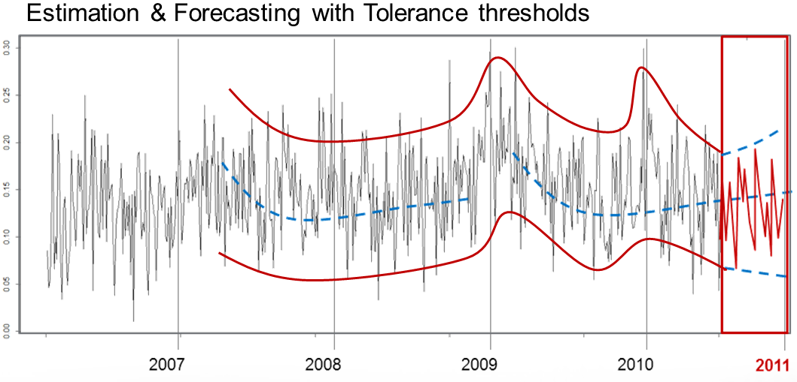
Telco. Infrastructure: general modeling (1 de 2)
A Time Series Estimation* per Operative KPI allows to have an estimation of a statistical and/or operative tolerance threshold; additionally is possible to build a forecasting per KPI.
Traffic forecast: total & per site
Outliers detection and expected traffic
* ARIMAX Time Series Modeling – note that the estimation will be hierarchical

Slide 50
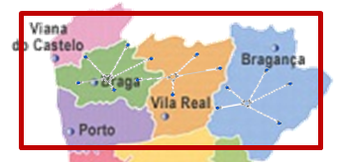
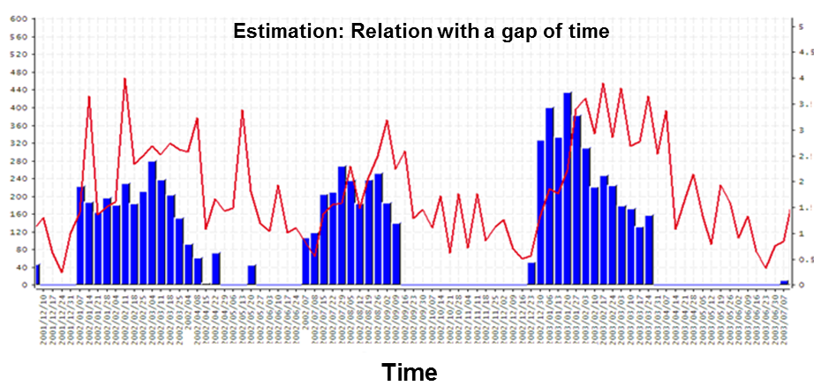
Telco. Infrastructure: general modeling (2 de 2)
Attending to the relationship between BTS we could forecast part of the traffic for the neighbor BTS and also we could make scenarios of traffic when saturations appears.
The relationship between some BTS in the network have a gap of time. It means that the changes in a period of time in a BTS makes changes in the next one.
Residential area
Day of the week
Highway
BTS
BTS
Time Series modeling is specially strength estimating this kind of relationship.
BTS
Business area
Hour within the day
We have the possibility to forecast impact in my site X when appear changes in my site Y

Slide 51
telecom market segmentation
Initial Requirements
Illustrative Graphs
Results
The global telecom operator in possession of historical data regarding the use and spend in telephone and communications services (fix line and mobile ), Internet and payTV .
A none differentiated offering, no advanced segmentation, lack of direction in sales actions, low “share of wallet” of main clients.
“Value opportunities” in segments with less sophisticated services demands.
The analysis revealed profiles for the launch of packages with two and three services.
Combinations of the services with greatest potential were identifies by past product evolutions
The positioning of the operator and its competitors were analyzed for all the clusters to see the erosion of the market share (important in the strategic clusters).
Churn was analyzed tfor services and for the operator (client entry and exit balance)
The segmentation allowed the simulation of offers of convergent offers and opportunity costs for the operator
La segmentaction allowed scenario creation that ment increase income growth of 28%.
Objectives
Create a segmentation that allows the operator to:
Group customer according to their use and attitude towards telecom services.
Discriminate segments and profiles according to value and spend
Target customer profile identification to make packaged service offers
Define customer groups and profiles interested in convergent none conventional offers (i.e. duos that include pay TV instead of Internet access)
Offer a first approximation to the definition of the final sales offer for target groups.
Análisis del valor cliente
Análisis de migraciones
Mapa de valor

Slide 52
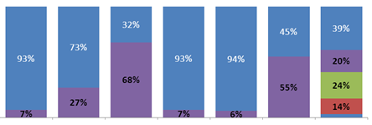
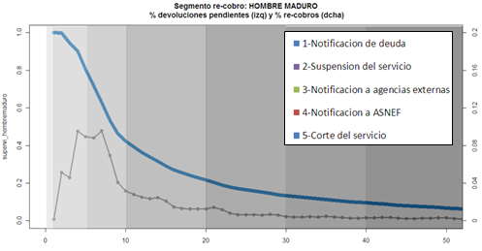
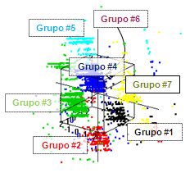


segmentation oriented towards collections of a telecom company.
Initial Requirements
Illustrative Graphs
Results
In collections management understanding the processes followed and the results obtained for optimal results, is absolutely required, specially in these down times.
There are systems that help the collection of overdue bills. These systems are effective only if they correctly contemplate the billing dynamics and the impacts of the actions taken.
Typification of entire customer set, identifying seven principal groups.
Identificaction of three significan payment periods and the actions that facilitate the collection in each stage.
Detection of significant factors in the frequency of unpaid invoices.
Defintion of the actions for collection based on segmentation and the different collection periods.
Objectives
Typify customers according to payment frequency and regarding behavior during collection.
Identify possible actions oriented towards optimizing the collection process.

Slide 53

multinational telephone operator
Initial Requirements
Illustrative Graphs
Results
Project for methodology definition in creating a tool that identifies patterns for collection and optimization for account recovery actions .
Identify the best recovery strategy.
Diminish the costs of non payments and improve the liquidity of the institution.
Estimation of the recovery profile.
Objectives
Recovery of past due billings and anticipation of likely candidates who will not pay. Anticipate the severity of the non payment by identifying payment patterns and the characterstics of the debt.

Slide 54




fix telephone demand forecasting for an important telephone company
Initial Requirements
Illustrative Graphs
Results
To have the required infrastructure telephone companies require a forecast of foreseen telephone accesses.
The dynamics of new lines is very heterogeneous and is conditioned by the areas where the service is to be provided.
A demand forecasting system for management.
Data Base system with the load processes for data integration.
Ad-hoc models for broad band.
Objectives
Fix line demand forecasting from national to telephone hub level.
Maintenance of the forecasting system. .
Creation of ad-hoc forecasting models.

